Slide 1
Bangladesh Army University of Engineering & Technology (BAUET)
HUM-3157
(Professional Ethics and Environmental Protection)
Course Instructor:
Mohammed Golam Sarwar Bhuyan
Professor, Dept. Of CSE
Dean, Faculty of Electrical and Computer Engineering (ECE)
Director, Institutional Quality Assurance Cell (IQAC)

Slide 2
Week 1: Introduction to Ethics
Learning Outcomes:
By the end of this week, students will be able to:
Understand the fundamental concepts of ethics.
Analyze the role of ethics in engineering practices.

Slide 3
Week 1: Introduction to Ethics
Definition of Ethics and Morality:
Ethics:
The branch of philosophy that deals with questions of morality, encompassing concepts such as right and wrong, good and evil, virtue and vice, justice, and fairness. Ethics involves the systematization, defense, and recommendation of these concepts.

Slide 4
Week 1: Introduction to Ethics
Definition of Ethics and Morality:
Morality:
The principles concerning the distinction between right and wrong or good and bad behavior. Morality often refers to personal or cultural values, codes of conduct, and social mores.

Slide 5
Week 1: Introduction to Ethics
Ethical theories: Deontology, Utilitarianism, Virtue Ethics
1. Deontology
Core Principle: Focuses on the duty and moral rules guiding actions. The rightness or wrongness of an action depends on its adherence to a set of rules or obligations, not on the consequences.
Philosophers: Immanuel Kant is a key figure. He emphasized acting in accordance with the Categorical Imperative (universal moral laws).
Key Ideas:
Actions are morally right if they respect others' rights and dignity.
People should never be treated as a means to an end but as ends themselves.
Example: A doctor refuses to lie to a patient about their prognosis because honesty is a moral duty, even if the truth may cause distress.
.

Slide 6
Week 1: Introduction to Ethics
Ethical theories: Deontology, Utilitarianism, Virtue Ethics
2. Utilitarianism
Core Principle: Actions are judged by their consequences, with the goal of maximizing overall happiness or reducing suffering for the greatest number of people.
Philosophers: Jeremy Bentham and John Stuart Mill are prominent proponents.
Key Ideas:
The Greatest Happiness Principle: The morally right action is the one that produces the most pleasure or the least pain.
Consequences, not intentions, determine morality.
Example: A company decides to relocate a factory to a low-income area, creating jobs for many people, even if it inconveniences a few nearby residents.
.

Slide 7
Week 1: Introduction to Ethics
Ethical theories: Deontology, Utilitarianism, Virtue Ethics
3. Virtue Ethics
Core Principle: Emphasizes character and the development of virtues (e.g., honesty, courage, compassion) rather than rules or consequences. The focus is on being a good person and living a life of moral excellence.
Philosophers: Aristotle is a central figure. He argued that virtues are habits cultivated through practice and that a virtuous person acts in accordance with practical wisdom (phronesis).
Key Ideas:
Ethical behavior is about cultivating virtues and living in harmony with one’s purpose (telos).
Strive for the Golden Mean, avoiding extremes of deficiency or excess in traits.
Example: A teacher goes beyond duty to mentor struggling students because they value compassion and generosity as part of their character.
.

Slide 8
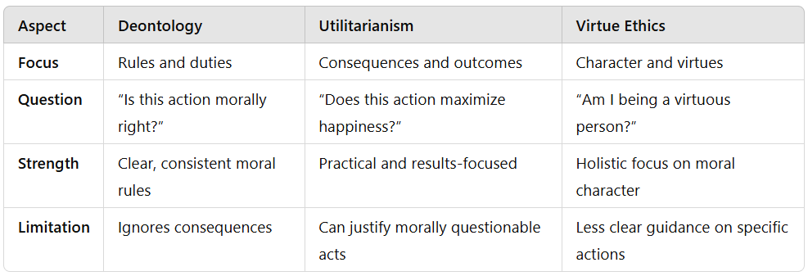
Week 1: Introduction to Ethics
Comparison of Ethical theories:
.

Slide 9
Week 1: Introduction to Ethics
Importance of Ethics in Engineering:
1. Responsibility to Society:
- Engineers have a duty to prioritize public welfare, safety, and health.
- Examples of ethical responsibilities include:
- Ensuring the safety and reliability of software systems.
- Protecting user data and privacy.
- Avoiding harm through responsible AI and machine learning practices.

Slide 10
Week 1: Introduction to Ethics
Importance of Ethics in Engineering:
2. Professional Integrity:
- Maintaining honesty, transparency, and trustworthiness in professional work.
- Importance of avoiding conflicts of interest, plagiarism, and intellectual property theft.
3. Legal and Regulatory Compliance:
- Adhering to laws, regulations, and industry standards that govern engineering practices.
- Understanding the legal implications of ethical decisions, such as data protection laws (e.g., GDPR).

Slide 11
Week 1: Introduction to Ethics
Importance of Ethics in Engineering:
4. Impact on Innovation and Progress:
- Ethical practices foster trust and credibility, which are essential for technological advancement and public acceptance.
- Case studies where ethical considerations led to innovative solutions and societal benefits.

Slide 12
Week 1: Introduction to Ethics
Importance of Ethics in Engineering:
5. Ethical Dilemmas and Decision-Making:
- Engineers often face complex ethical dilemmas where they must balance competing interests and make difficult decisions.
- Frameworks for ethical decision-making:
-Identifying stakeholders and their interests.
- Analyzing the potential consequences of different actions.
- Applying ethical principles to determine the best course of action.

Slide 13
Week 1: Introduction to Ethics
Application to Engineering:
The above concepts apply specifically to the field of Computer Science and Engineering. Examples include:
- Ethical programming practices.
- Data privacy and security.
- Intellectual property and plagiarism.
Case Studies:
Examine real-world scenarios where ethical principles were challenged, such as data breaches or software malfunctions that had significant consequences.

Slide 14
Week 1: Introduction to Ethics
Review Questions and Answers:
Question (Value): How do you personally value ethics in your professional decision-making process, and can you share an example where adhering to ethical principles guided your actions?
Question (Respond): How do you feel about the role of ethics in shaping trust and accountability within your professional field or society?
Question (Organize): How would you prioritize the application of Deontology, Utilitarianism, and Virtue Ethics in resolving an ethical dilemma in your profession? Can you suggest a structured approach to balance these theories in practice?

Slide 15
Week 1: Introduction to Ethics
Thank You all

